Slide 1

Climate Change
Environment & Empire
A-Level Geography
CASE STUDY
India
Notes:
TEACHER NOTES
The aim of each teaching resource in this pack is to encourage students to explore:
The effects and consequences of empire on geography
The contributions of non-European people to the study of geography
The aim is therefore to both decolonise and diversify the teaching of geography.
SENSITIVITY GUIDANCE
Some students, particularly those with family in South Asia, particularly India and Bangladesh, may have been personally affected by the events described in this case—both the history of colonialism and potentially the especially the more recent flooding in South Asia.
We advise that students are informed in advance about the content, but also empowered, where they feel comfortable to share their own experiences and perspectives.
SPECIFICATION
AQA A-Level Geography
3.1.1.4 Water, carbon, climate and life on Earth
The key role of the carbon and water stores and cycles in supporting life on Earth with particular reference to climate.
The relationship between the water cycle and carbon cycle in the atmosphere.
The role of feedbacks within and between cycles and their link to climate change and implications for life on Earth.
Human interventions in the carbon cycle designed to influence carbon transfers and mitigate the impacts of climate change.
3.1.5.5 Storm hazards
The nature of tropical storms and their underlying causes.
Forms of storm hazard: high winds, storm surges, coastal flooding, river flooding and landslides.
Spatial distribution, magnitude, frequency, regularity, predictability of hazard events.
Impacts: primary/secondary, environmental, social, economic, political.
Short and long-term responses: risk management designed to reduce the impacts of the hazard through preparedness, mitigation, prevention and adaptation.
3.1.5.7 Case Studies
Case study of a multi-hazardous environment beyond the UK to illustrate and analyse the nature of the hazards and the social, economic and environmental risks presented, and how human qualities and responses such as resilience, adaptation, mitigation and management contribute to its continuing human occupation.
COPYRIGHT AND TERMS
All content is provided under the Creative Commons Attribution 4.0 license: https://creativecommons.org/licenses/by/4.0/
Images rights are held by respective copyright holders
For further information about the project, please see https://environmentandempire.org.uk/

Slide 2
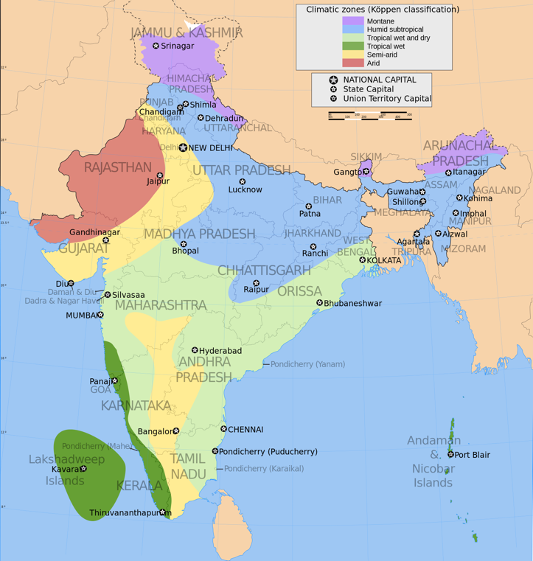
Climate Change in India
The effects of climate change on the environment and people in India include:
Flooding
Storms
Sea level rise
Heat waves
Extreme weather events
Poverty
Crop failure
Forced migration
Map of climate zones in India. Wikimedia.
Notes:
SPECIFICATION
AQA A-Level Geography
3.1.1.4 Water, carbon, climate and life on Earth
The role of feedbacks within and between cycles and their link to climate change and implications for life on Earth.
Human interventions in the carbon cycle designed to influence carbon transfers and mitigate the impacts of climate change.
3.1.5.7 Case Studies
Case study of a multi-hazardous environment beyond the UK to illustrate and analyse the nature of the hazards and the social, economic and environmental risks presented, and how human qualities and responses such as resilience, adaptation, mitigation and management contribute to its continuing human occupation.

Slide 3
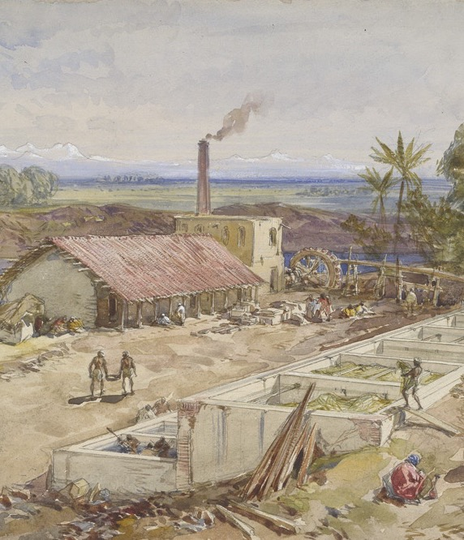
Climate Change and Empire
India was part of the British Empire up until independence in 1947.
The British believed that the Indian climate made it rich in natural resources.
But the British worried that the climate in India was extreme and hard to predict.
Extreme weather events had social, economic, political and environmental impacts.
How did British colonialism shape the impacts and responses to climate change in India?
Indigo factory, Bengal, India, Wikimedia
Notes:
SPECIFICATION
AQA A-Level Geography
3.1.1.4 Water, carbon, climate and life on Earth
The role of feedbacks within and between cycles and their link to climate change and implications for life on Earth.
Human interventions in the carbon cycle designed to influence carbon transfers and mitigate the impacts of climate change.
3.1.5.7 Case Studies
Case study of a multi-hazardous environment beyond the UK to illustrate and analyse the nature of the hazards and the social, economic and environmental risks presented, and how human qualities and responses such as resilience, adaptation, mitigation and management contribute to its continuing human occupation.

Slide 4
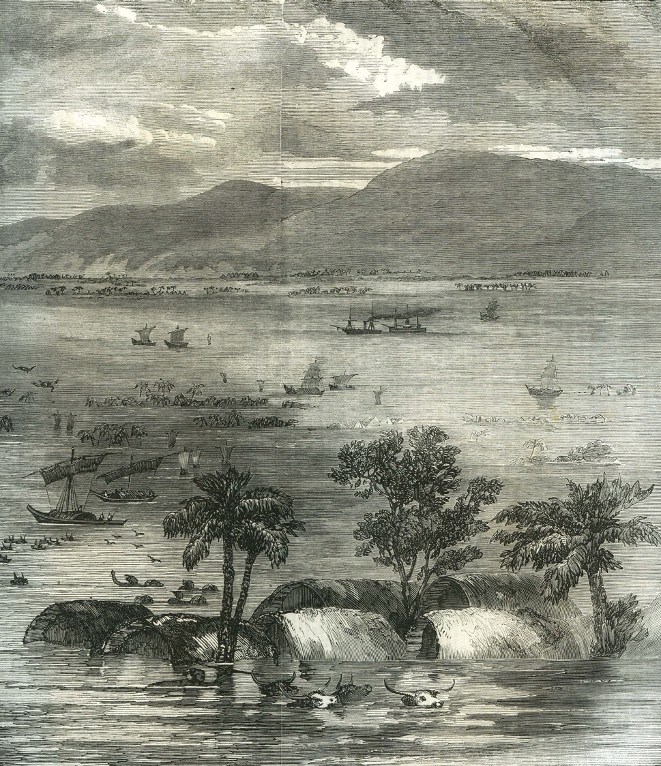
Extreme Weather in Colonial India
The River Ganges frequently floods.
Floods often occur following a tropical cyclone or the monsoon rains.
Major flooding occurred in Bengal, British India in 1856, 1871, 1885, 1892, 1899, 1902, 1906, 1918, and 1922.
Crop failure and famine followed the 1902 and 1906 floods.
Over 7,000 houses were destroyed in the 1918 floods.
What difference did colonialism make?
“Inundation in India”, Illustrated London News (1856)
Notes:
TEACHER NOTES
You may wish to briefly explain the meaning of ”monsoon” and “tropical cyclone”.
You may wish to discuss why flooding resulted in crop failure and famine.
SPECIFICATION
AQA A-Level Geography
3.1.5.5 Storm hazards
The nature of tropical storms and their underlying causes.
Forms of storm hazard: high winds, storm surges, coastal flooding, river flooding and landslides.
Spatial distribution, magnitude, frequency, regularity, predictability of hazard events.
Impacts: primary/secondary, environmental, social, economic, political.
Short and long-term responses: risk management designed to reduce the impacts of the hazard through preparedness, mitigation, prevention and adaptation.
3.1.5.7 Case Studies
Case study of a multi-hazardous environment beyond the UK to illustrate and analyse the nature of the hazards and the social, economic and environmental risks presented, and how human qualities and responses such as resilience, adaptation, mitigation and management contribute to its continuing human occupation.

Slide 5
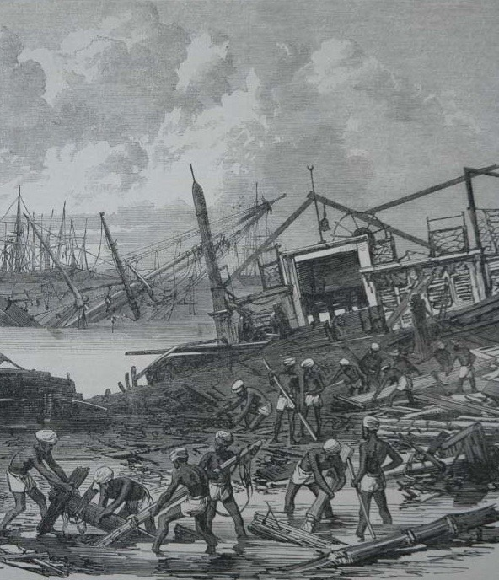
Causes and Effects of Flooding
Floods were primarily caused by natural factors (such as increased rainfall).
However, the effects were made worse by human factors (such as colonialism).
Colonialism increased the demand for fertile land, resulting in deforestation.
Colonialism caused more people to live in crowded urban environments near the sea or river.
Colonial infrastructure, such as railways and embankments, disrupted the natural flow of flood waters.
“Effects of the Cyclone at Calcutta”, Illustrated London News (1864)
Notes:
TEACHER NOTES
This is a good opportunity to distinguish between natural and human factors, as well as the difference between causes and effects.
You may wish to discuss why deforestation, urbanisation, and new infrastructure exacerbated the effects of flooding.
SPECIFICATION
AQA A-Level Geography
3.1.5.5 Storm hazards
The nature of tropical storms and their underlying causes.
Forms of storm hazard: high winds, storm surges, coastal flooding, river flooding and landslides.
Spatial distribution, magnitude, frequency, regularity, predictability of hazard events.
Impacts: primary/secondary, environmental, social, economic, political.
Short and long-term responses: risk management designed to reduce the impacts of the hazard through preparedness, mitigation, prevention and adaptation.
3.1.5.7 Case Studies
Case study of a multi-hazardous environment beyond the UK to illustrate and analyse the nature of the hazards and the social, economic and environmental risks presented, and how human qualities and responses such as resilience, adaptation, mitigation and management contribute to its continuing human occupation.

Slide 6
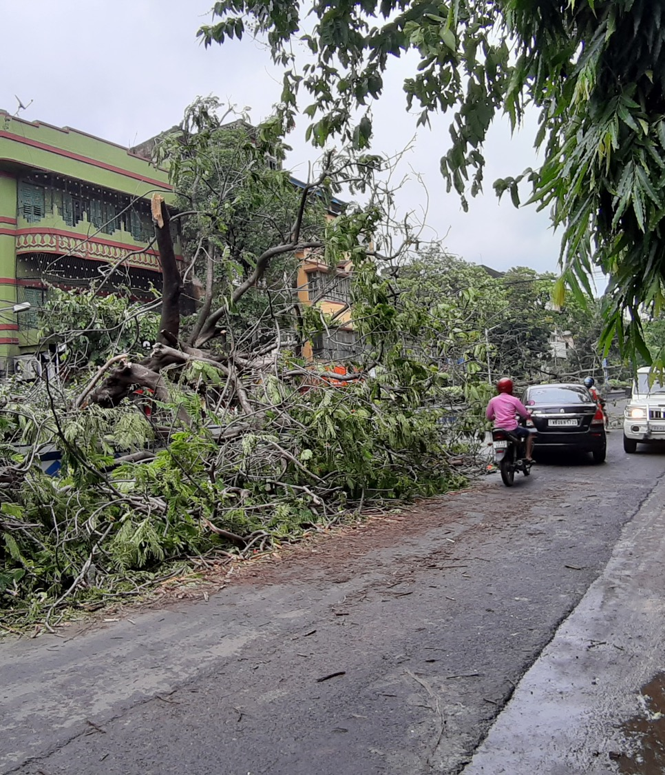
Climate Change after Independence
India gained independence from the British Empire in 1947.
Since 1947, Indian geographers and climate scientists have played an important role in:
Understanding climate change
Managing climate change
In 2020, major flooding in India caused $88.5 billion of damage and killed over 5,000 people.
Kolkata, India, 2020. Wikimedia
Notes:
SPECIFICATION
AQA GCSE Geography
3.1.1 Section A: The challenge of natural hazards
SPECIFICATION
AQA A-Level Geography
3.1.1.4 Water, carbon, climate and life on Earth
The role of feedbacks within and between cycles and their link to climate change and implications for life on Earth.
Human interventions in the carbon cycle designed to influence carbon transfers and mitigate the impacts of climate change.
3.1.5.5 Storm hazards
Short and long-term responses: risk management designed to reduce the impacts of the hazard through preparedness, mitigation, prevention and adaptation.
3.1.5.7 Case Studies
Case study of a multi-hazardous environment beyond the UK to illustrate and analyse the nature of the hazards and the social, economic and environmental risks presented, and how human qualities and responses such as resilience, adaptation, mitigation and management contribute to its continuing human occupation.

Slide 7
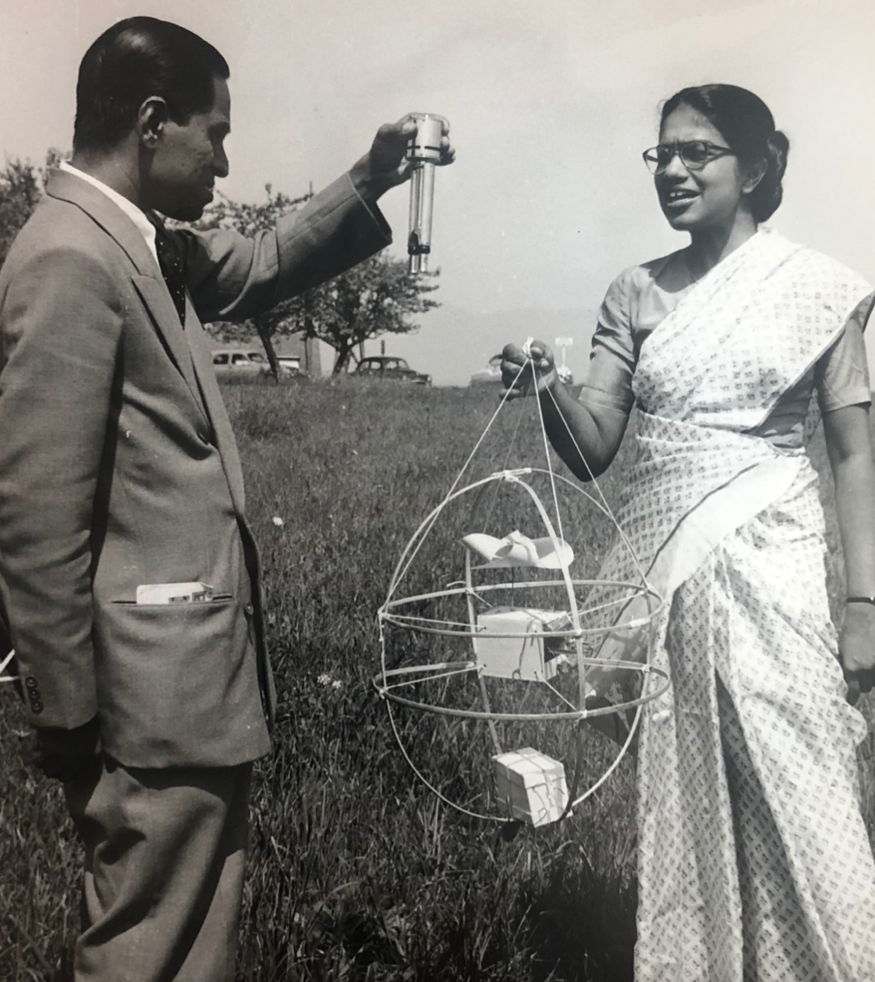
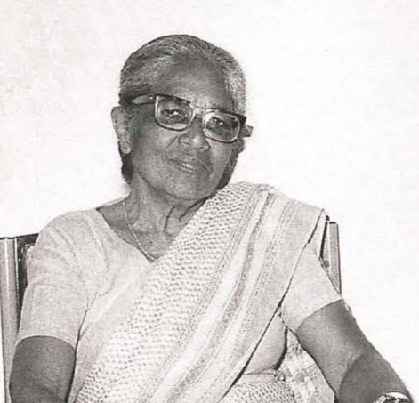
Anna Mani
Studied physics at Pachaiyappas College in Madras (Chennai), British India in 1930s.
Further study at Imperial College, London, UK in 1930s.
Campaigned for Indian independence.
Joined Indian Meteorological Department in 1940s.
Studied effects of solar radiation on weather and ozone layer in India
“Miss Anna Mani Interview with Dr Hessam Taba” WMO Bulletin 40 (1991)
Notes:
TEACHER NOTES
Highlight the following to students:
Mani’s career highlights the importance of training and institutions for the development of climate science.
Mani is a good example of the important role played by women in Indian climate science.
Mani saw her work as directly contributing to building and protecting Indian independence.
For an interview with Anna Mani, see: Hessam Taba, “Miss Anna Mani,” WHO Bulletin, 1991 (40): https://public.wmo.int/en/media/news/celebrating-pioneer-indian-meteorologist-anna-mani
SPECIFICATION
AQA A-Level Geography
3.1.1.4 Water, carbon, climate and life on Earth
The role of feedbacks within and between cycles and their link to climate change and implications for life on Earth.
Human interventions in the carbon cycle designed to influence carbon transfers and mitigate the impacts of climate change.
3.1.5.5 Storm hazards
Short and long-term responses: risk management designed to reduce the impacts of the hazard through preparedness, mitigation, prevention and adaptation.
3.1.5.7 Case Studies
Case study of a multi-hazardous environment beyond the UK to illustrate and analyse the nature of the hazards and the social, economic and environmental risks presented, and how human qualities and responses such as resilience, adaptation, mitigation and management contribute to its continuing human occupation.

Slide 8
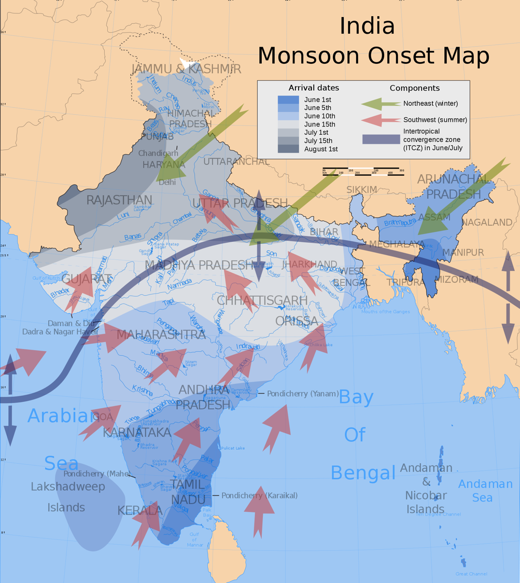
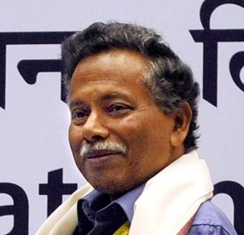
Bhupendra Nath Goswami
Studied physics at Guwahati University, and University of Gujarat, India in 1970s.
Further study at Massachusetts Institute of Technology, USA in 1970s.
Chairman of the Centre for Atmospheric and Oceanic Sciences, Bangalore, India.
Develops model to predict pattern of the monsoon.
_{Map of the monsoon, Wikimedia}
Notes:
TEACHER NOTES
Highlight the following to students:
Goswami’s career highlights the importance of training and institutions for development of climate science.
Goswami’s research highlights the importance of accurate models for mitigation and adaptation to climate change.
SPECIFICATION
AQA A-Level Geography
3.1.1.4 Water, carbon, climate and life on Earth
The role of feedbacks within and between cycles and their link to climate change and implications for life on Earth.
Human interventions in the carbon cycle designed to influence carbon transfers and mitigate the impacts of climate change.
3.1.5.5 Storm hazards
The nature of tropical storms and their underlying causes.
Forms of storm hazard: high winds, storm surges, coastal flooding, river flooding and landslides.
Spatial distribution, magnitude, frequency, regularity, predictability of hazard events.
Short and long-term responses: risk management designed to reduce the impacts of the hazard through preparedness, mitigation, prevention and adaptation.
3.1.5.7 Case Studies
Case study of a multi-hazardous environment beyond the UK to illustrate and analyse the nature of the hazards and the social, economic and environmental risks presented, and how human qualities and responses such as resilience, adaptation, mitigation and management contribute to its continuing human occupation.

