Slide 1

Hot Deserts
Environment & Empire
GCSE Geography
CASE STUDY
Sudan
Notes:
TEACHER NOTES
The aim of each teaching resource in this pack is to encourage students to explore:
The effects and consequences of empire on geography
The contributions of non-European people to the study of geography
The aim is therefore to both decolonise and diversify the teaching of geography.
SENSITIVITY GUIDANCE
Some students, particularly those from Sudan, or with family in Sudan, may have been personally affected by the events described in this case—both the history of colonialism and especially the more recent history of conflict and famine.
We advise that students are informed in advance about the content, but also empowered, where they feel comfortable to share their own experiences and perspectives.
SPECIFICATION
AQA GCSE Geography
3.1.2 Section B: The living world
3.1.2.3 Hot deserts
Hot desert ecosystems have a range of distinctive characteristics.
Development of hot desert environments creates opportunities and challenges.
Areas on the fringe of hot deserts are at risk of desertification.
COPYRIGHT AND TERMS
All content is provided under the Creative Commons Attribution 4.0 license: https://creativecommons.org/licenses/by/4.0/
Images rights are held by respective copyright holders
For further information about the project, please see https://environmentandempire.org.uk/

Slide 2
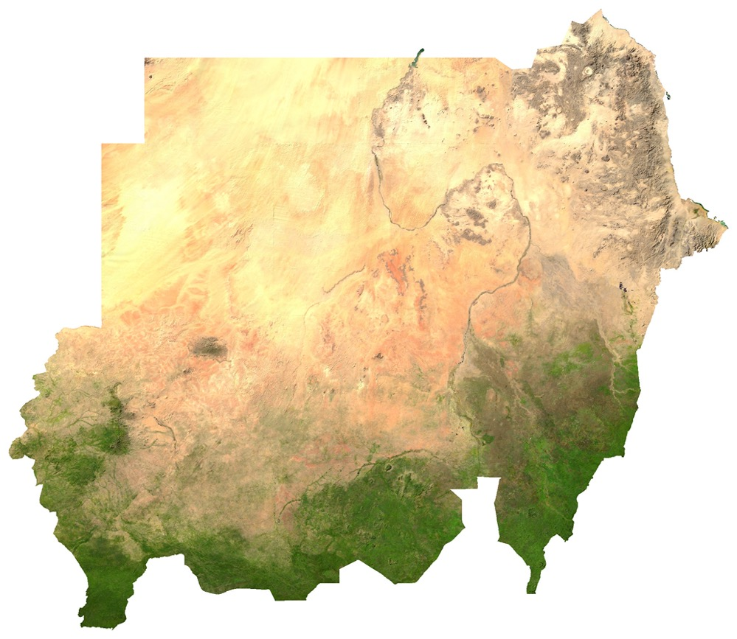
Hot Deserts in Sudan
Hot Deserts in Sudan
Sudan is a large country in Northeast Africa.
The north of Sudan is made up of a number of large hot deserts.
These include:
  The Nubian Desert (approximately 400,000 km² area)
  The Bayuda Desert (approximately 100,000 km² area)
Both of these deserts are part of the Sahara Desert which stretches across North Africa.
Satellite image of Sudan
Notes:
SPECIFICATION
AQA GCSE Geography
3.1.2 Section B: The living world
3.1.2.3 Hot deserts
Hot desert ecosystems have a range of distinctive characteristics.
The physical characteristics of a hot desert.

Slide 3
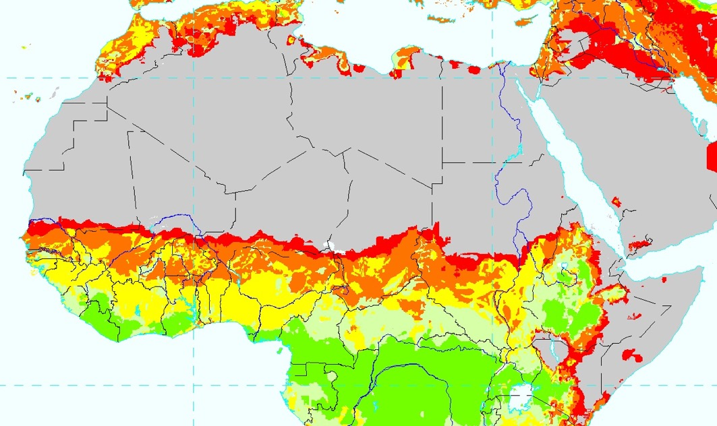
Desertification in Sudan
Desertification is when fertile land transforms into desert.
It is a type of land degradation.
The Sahara Desert has expanded by about 10% since 1920.
Over 50% of Sudan is at risk of desertification.
Sudan has experienced multiple severe droughts and famines.
In 1984, a severe drought saw rainfall reduced by 40%.
Sudan
Map indicating vulnerability to desertification.
Red indicates areas of very high vulnerability.
Notes:
SPECIFICATION
AQA GCSE Geography
3.1.2 Section B: The living world
3.1.2.3 Hot deserts
Hot desert ecosystems have a range of distinctive characteristics.
The physical characteristics of a hot desert.
Areas on the fringe of hot deserts are at risk of desertification.
Causes of desertification – climate change, population growth, removal of fuel wood, overgrazing, over-cultivation and soil erosion.

Slide 4
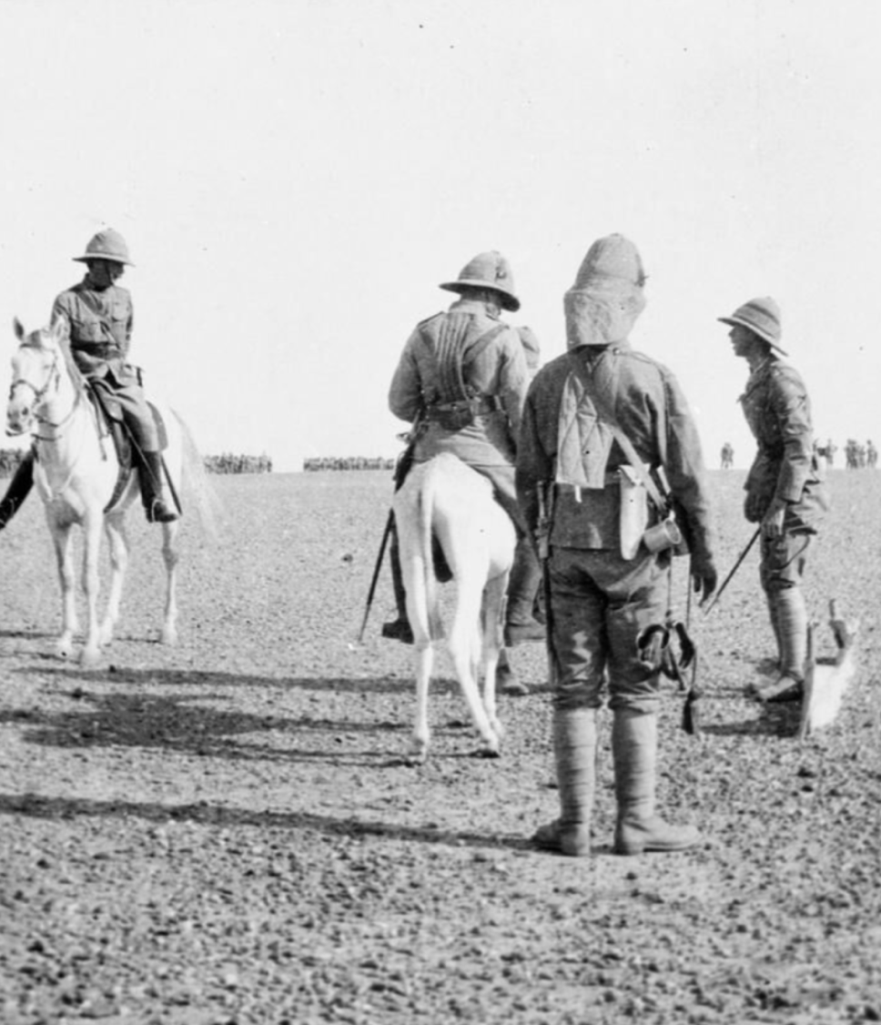
Desertification and Empire in Sudan
Sudan was part of the British Empire from 1899 to 1956.
Sudan was ruled by both Britain and Egypt as part of Anglo-Egyptian Sudan.
Major droughts occurred in 1913 and 1940.
The British worried about irregular rainfall and the loss of forests in Sudan.
Desertification was identified and discussed by British colonial geographers in the 1920s.
What difference did British colonialism make to desertification?
Anglo-Egyptian Nile Campaign, Sudan, 1898, Imperial War Museum
Notes:
SPECIFICATION
AQA GCSE Geography
3.1.2 Section B: The living world
3.1.2.3 Hot deserts
Development of hot desert environments creates opportunities and challenges.
Areas on the fringe of hot deserts are at risk of desertification.
Causes of desertification – climate change, population growth, removal of fuel wood, overgrazing, over-cultivation and soil erosion.
A case study of a hot desert to illustrate:
development opportunities in hot desert environments: mineral extraction, energy, farming, tourism
challenges of developing hot desert environments: extreme temperatures, water supply, inaccessibility.

Slide 5
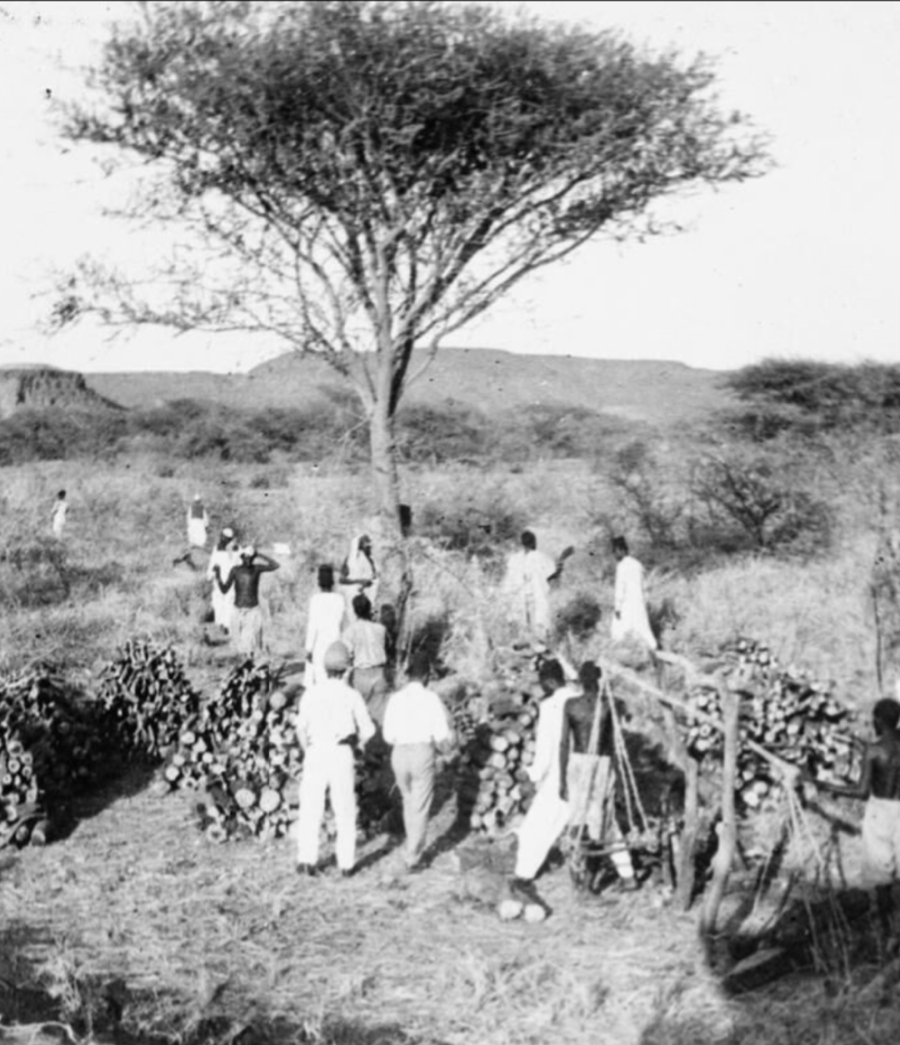
Causes of Desertification
Desertification is caused by both natural factors and human factors.
Colonialism increased the effects of certain human factors.
The British wanted to set up cash crop plantations in Sudan, to grow cotton and peanuts.
This resulted in overcultivation and deforestation.
But British colonial geographers blamed Sudanese farmers.
Anglo-Egyptian Nile Campaign, Sudan, 1898, Imperial War Museum
Notes:
TEACHER NOTES
This is a good opportunity to distinguish between natural and human factors, as well as the difference between causes and effects.
You may wish to discuss why deforestation and overdevelopment of agriculture increased the risk of desertification.
SPECIFICATION
AQA GCSE Geography
3.1.2 Section B: The living world
3.1.2.3 Hot deserts
Development of hot desert environments creates opportunities and challenges.
Areas on the fringe of hot deserts are at risk of desertification.
Causes of desertification – climate change, population growth, removal of fuel wood, overgrazing, over-cultivation and soil erosion.
A case study of a hot desert to illustrate:
development opportunities in hot desert environments: mineral extraction, energy, farming, tourism
challenges of developing hot desert environments: extreme temperatures, water supply, inaccessibility.

Slide 6
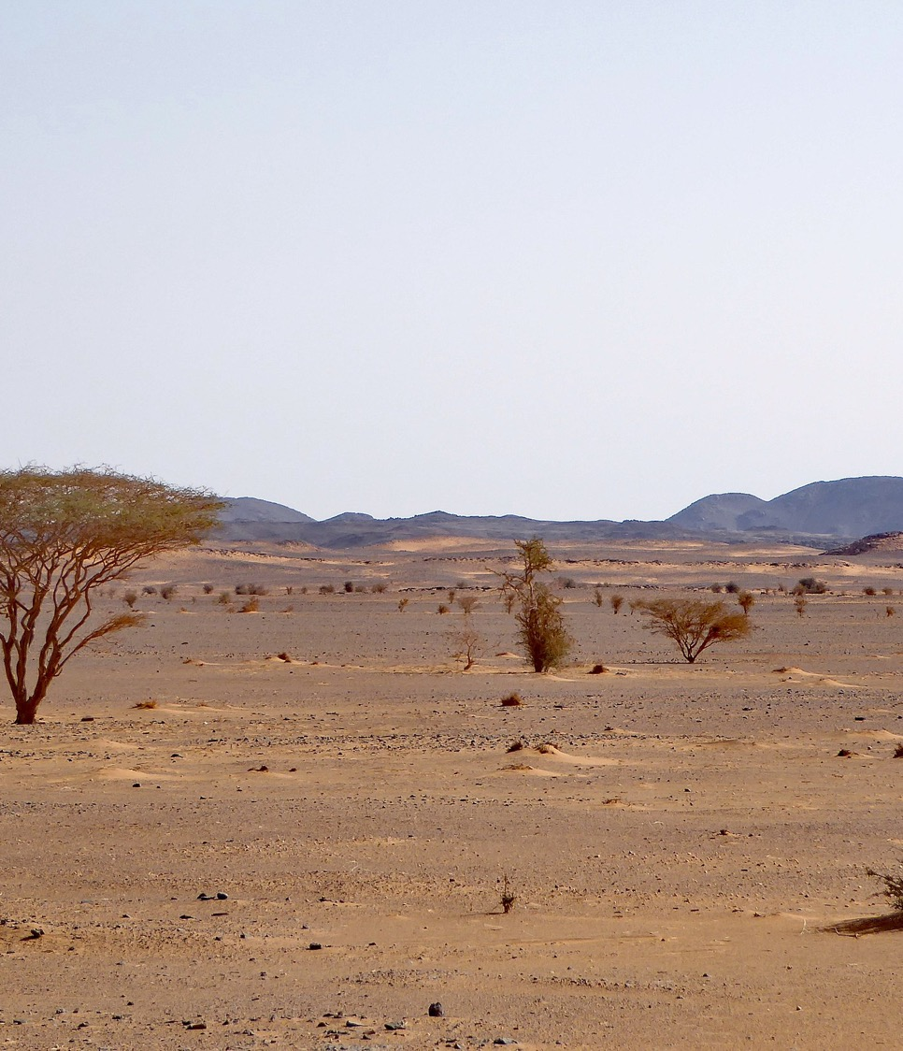
Desertification After Independence
Sudan gained independence from the British Empire in 1956.
Since 1956, Sudanese geographers and scientists have played an important role in:
  Understanding desertification
  Reducing the risk of desertification
However, desertification is contributing to ongoing conflict in Sudan, as resources are scarce and people are displaced.
South Sudan became independent from Sudan in 2011.
Nubian Desert, Sudan, Wikimedia
Notes:
TEACHER NOTES
You may wish to briefly explain that South Sudan is now a separate country, as it gained independence from Sudan in 2011. You may also wish to discuss how the North-South divide in Sudan was exacerbated both by colonialism and desertification.
SPECIFICATION
AQA GCSE Geography
3.1.2 Section B: The living world
3.1.2.3 Hot deserts
Development of hot desert environments creates opportunities and challenges.
Areas on the fringe of hot deserts are at risk of desertification.
Causes of desertification – climate change, population growth, removal of fuel wood, overgrazing, over-cultivation and soil erosion.
Strategies used to reduce the risk of desertification – water and soil management, tree planting and use of appropriate technology.
A case study of a hot desert to illustrate:
development opportunities in hot desert environments: mineral extraction, energy, farming, tourism
challenges of developing hot desert environments: extreme temperatures, water supply, inaccessibility.

Slide 7
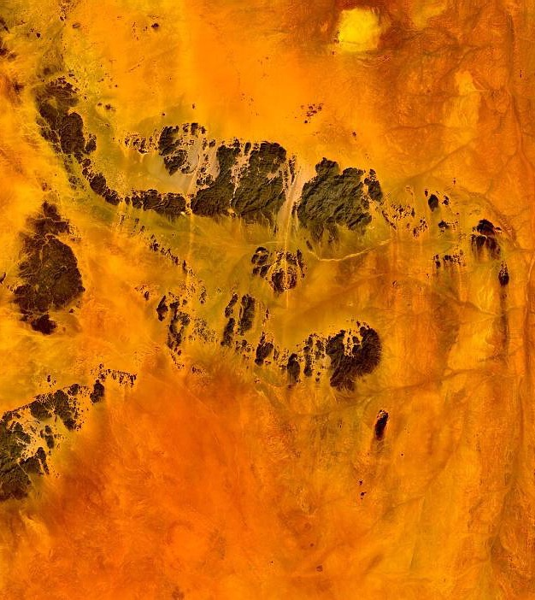

Mohamed Hag Ali Hassan
Born in Sudan in 1947, under colonial rule.
Completed a PhD in physics at the University of Oxford, UK in 1974.
Worked as professor at the University of Khartoum, Sudan in 1980s.
Developed first detailed account of physics of desertification in 1986.
Advocates for building scientific capacity in African countries.
Nubian Desert, Sudan, Wikimedia
Notes:
TEACHER NOTES
Highlight the following to students:
Ali Hassan is a good example of the role of different scientific disciplines in understanding desertification.
Ali Hassan is a good example of the importance of training and institutions for the development of geography.
You may wish to explain what ‘building scientific capacity’ means and ask the students why this is important.
SPECIFICATION
AQA GCSE Geography
3.1.2 Section B: The living world
3.1.2.3 Hot deserts
Development of hot desert environments creates opportunities and challenges.
Areas on the fringe of hot deserts are at risk of desertification.
Causes of desertification – climate change, population growth, removal of fuel wood, overgrazing, over-cultivation and soil erosion.
Strategies used to reduce the risk of desertification – water and soil management, tree planting and use of appropriate technology.
A case study of a hot desert to illustrate:
development opportunities in hot desert environments: mineral extraction, energy, farming, tourism
challenges of developing hot desert environments: extreme temperatures, water supply, inaccessibility.

Slide 8
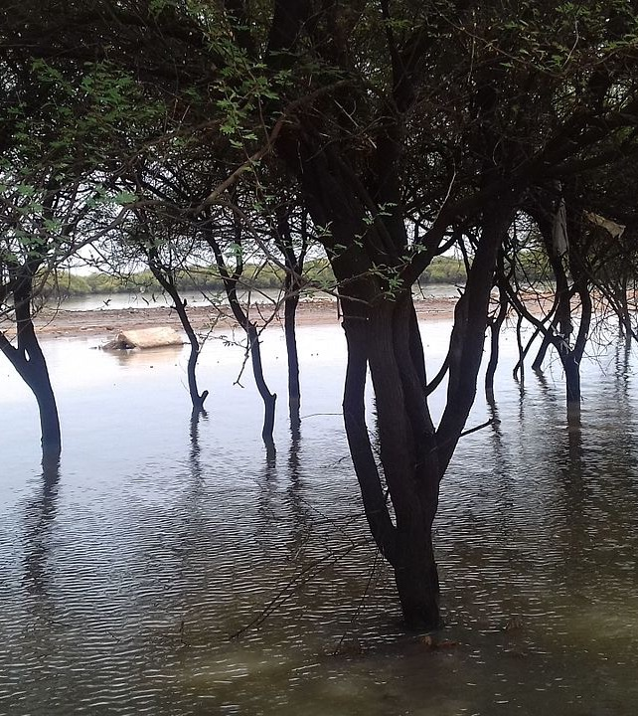

Balgis Osman-Elasha
Completed PhD in Forestry Science at University of Khartoum, Sudan in 1980s.
A lead writer for Intergovernmental Panel on Climate Change in 2007.
Quantified social and economic effects of desertification and climate change in Sudan.
Developed community-based solutions to deforestation and desertification.
Forest, Khartoum, Sudan, Wikimedia
Notes:
TEACHER NOTES
Highlight the following to students:
Osman-Elasha is a good example of the important role played by women in Sudanese and international desert science.
Osman-Elasha is a good example of the importance of forestry and climate science for understanding hot deserts and desertification.
You may wish to explain what “community-based solutions” means and ask the students why this is important.
SPECIFICATION
AQA GCSE Geography
3.1.2 Section B: The living world
3.1.2.3 Hot deserts
Development of hot desert environments creates opportunities and challenges.
Areas on the fringe of hot deserts are at risk of desertification.
Causes of desertification – climate change, population growth, removal of fuel wood, overgrazing, over-cultivation and soil erosion.
Strategies used to reduce the risk of desertification – water and soil management, tree planting and use of appropriate technology.
A case study of a hot desert to illustrate:
development opportunities in hot desert environments: mineral extraction, energy, farming, tourism
challenges of developing hot desert environments: extreme temperatures, water supply, inaccessibility.

